Slide 1
Teaching artist workshops
RESEARCH EVALUATION

Slide 2

TEACHING ARTIST WORKSHOPS
VALIDITY

Slide 3

TEACHING ARTIST WORKSHOPS
RELIABILITY

Slide 4

TEACHING ARTIST WORKSHOPS
FOCUS GROUP CONCLUSIONS

Slide 5
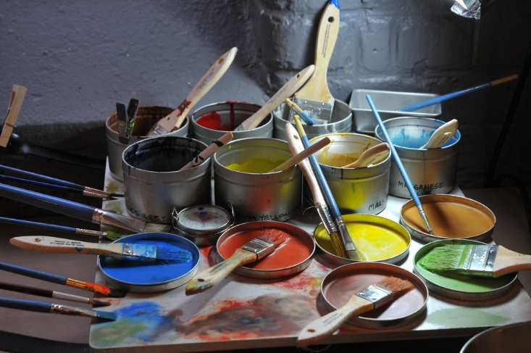
TEACHING ARTIST WORKSHOPS
SURVEY CONCLUSIONS

Slide 6

TEACHING ARTIST WORKSHOPS
SURPRISES

Slide 7

TEACHING ARTIST WORKSHOPS
LESSONS LEARNED

Slide 8
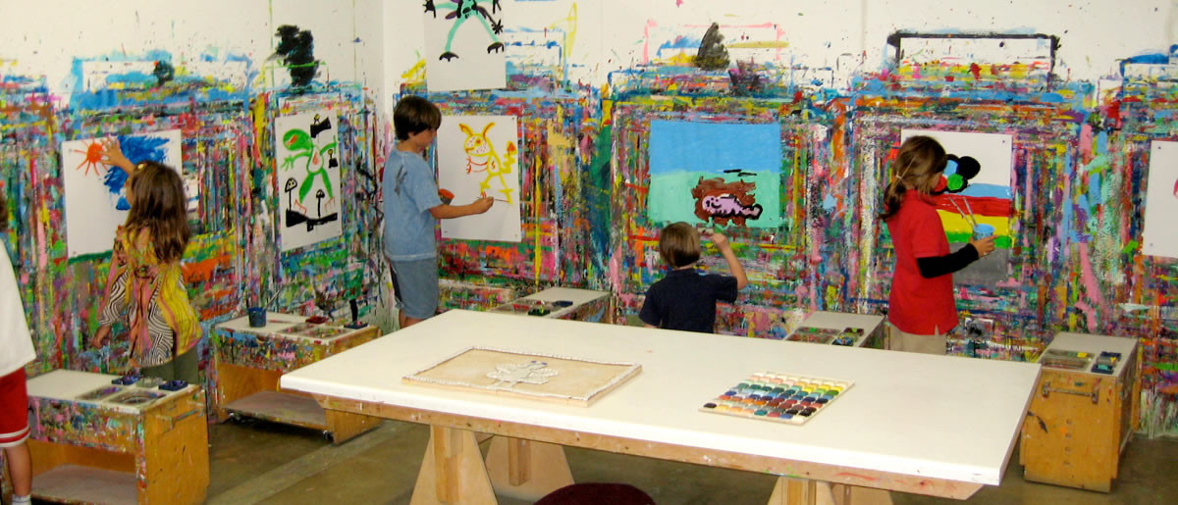
TEACHING ARTIST WORKSHOPS
FUTURE RESEARCH

Slide 9
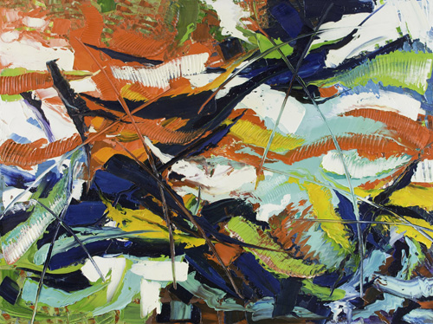
TEACHING ARTIST WORKSHOPS
SUMMARY

Slide 10
TEACHING ARTIST WORKSHOPS
REFERENCES
Booth, E. (2010). The Music Teaching Artist's Bible: Becoming a Virtuoso Educator. Toronto: CNIB.
How many questions should a good survey have? - Benchmark Email. (2018, August 06). Retrieved from https://kb.benchmarkemail.com/how-many-questions-should-a-good-survey-have/
Kaden, R. J., Linda, G., & Prince, M. (2012). Leading edge marketing research: 21st-Century tools and practices. Thousand Oaks (California): SAGE.
Kate, Clark, Brown, Vivienne, & John. (2003, May 01). Good practice in the conduct and reporting of survey research. Retrieved from https://academic.oup.com/intqhc/article/15/3/261/1856193
Our Mission. (n.d.). Retrieved from https://teachingartistsguild.org/about/
The Planning-Evaluation Cycle. (n.d.). Retrieved from http://socialresearchmethods.net/kb/pecycle.php
What are some common objectives for surveys? - Benchmark Email. (2018, August 06). Retrieved from https://kb.benchmarkemail.com/what-are-some-common-objectives-for-surveys/

